Slide 1
The Gambia - VLR INFORMATION SESSION WORKSHOP –
02 July 2021

Slide 2


Slide 3
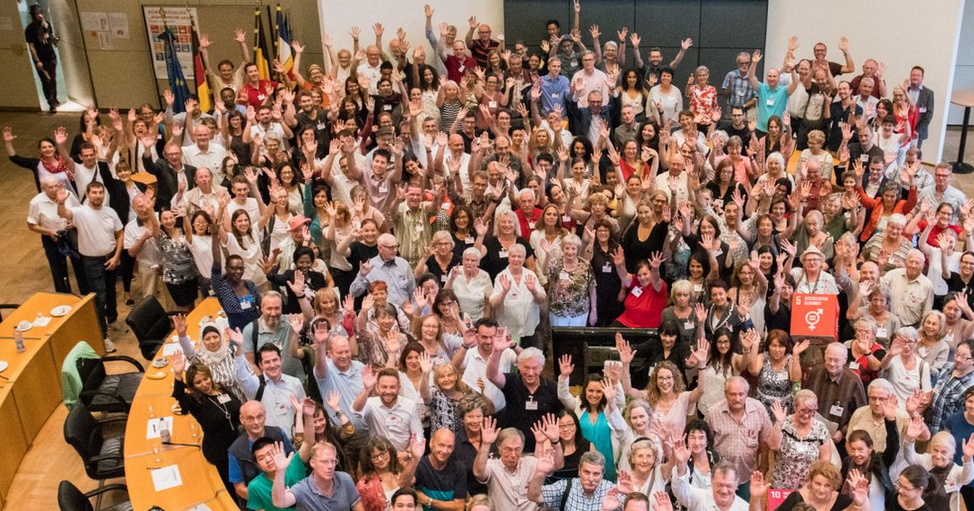
Dialogue with citizens
Fairtrade
Climateneutrality
Social Justice

Slide 4
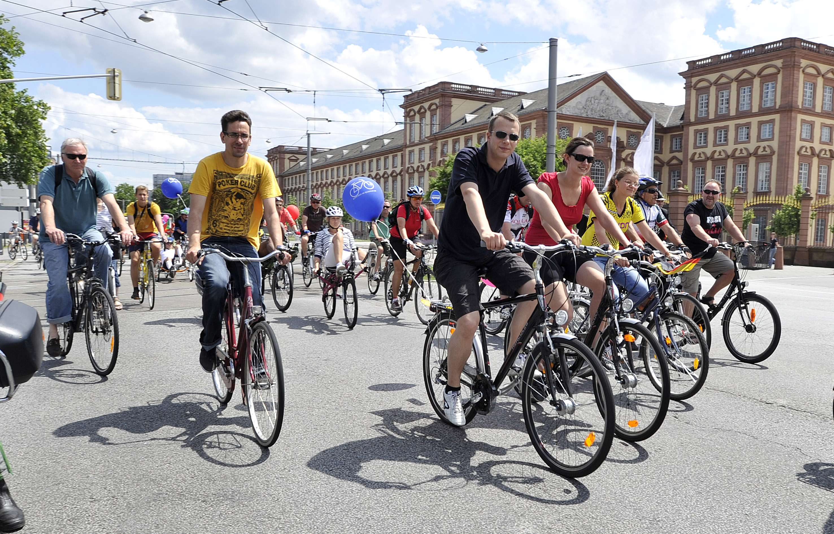








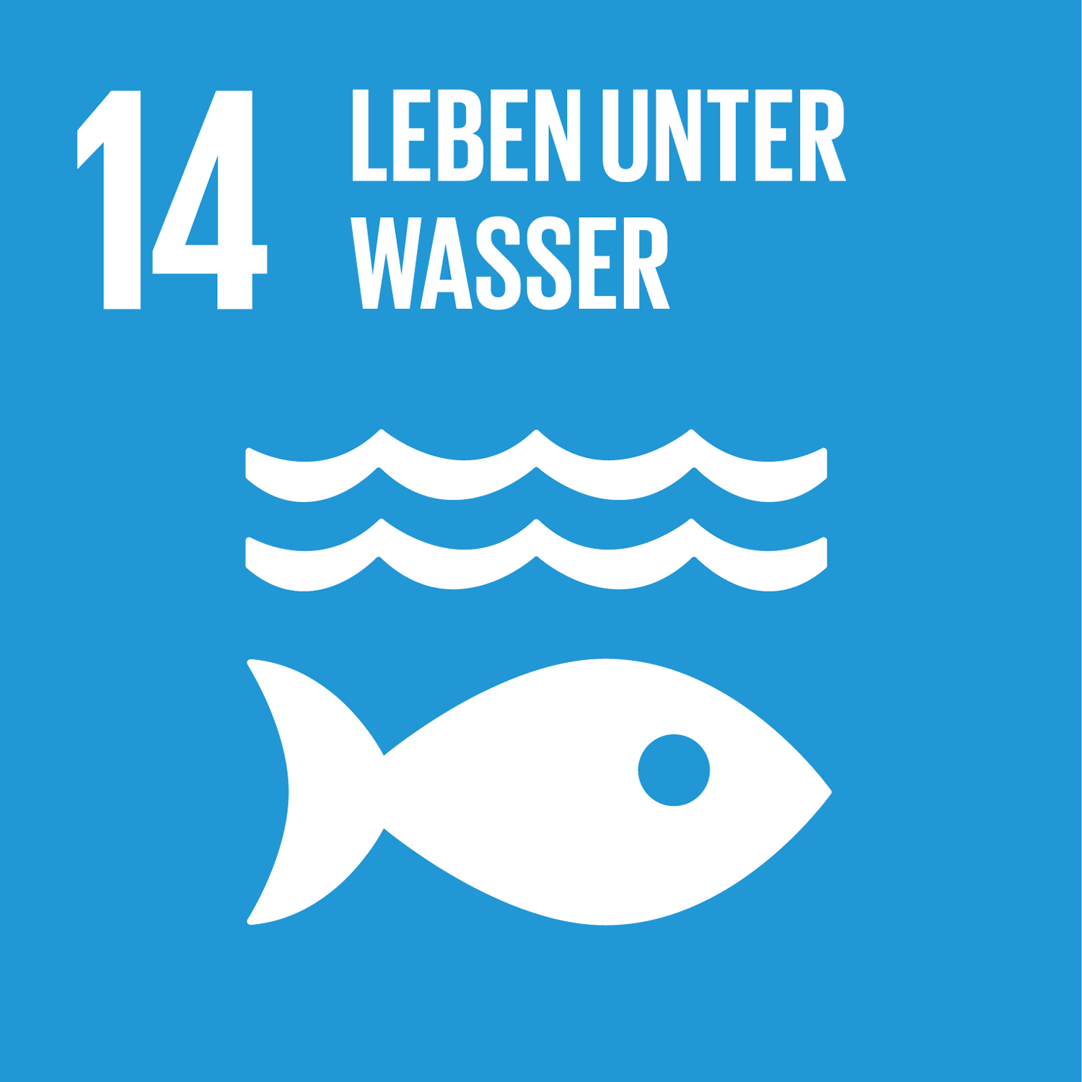
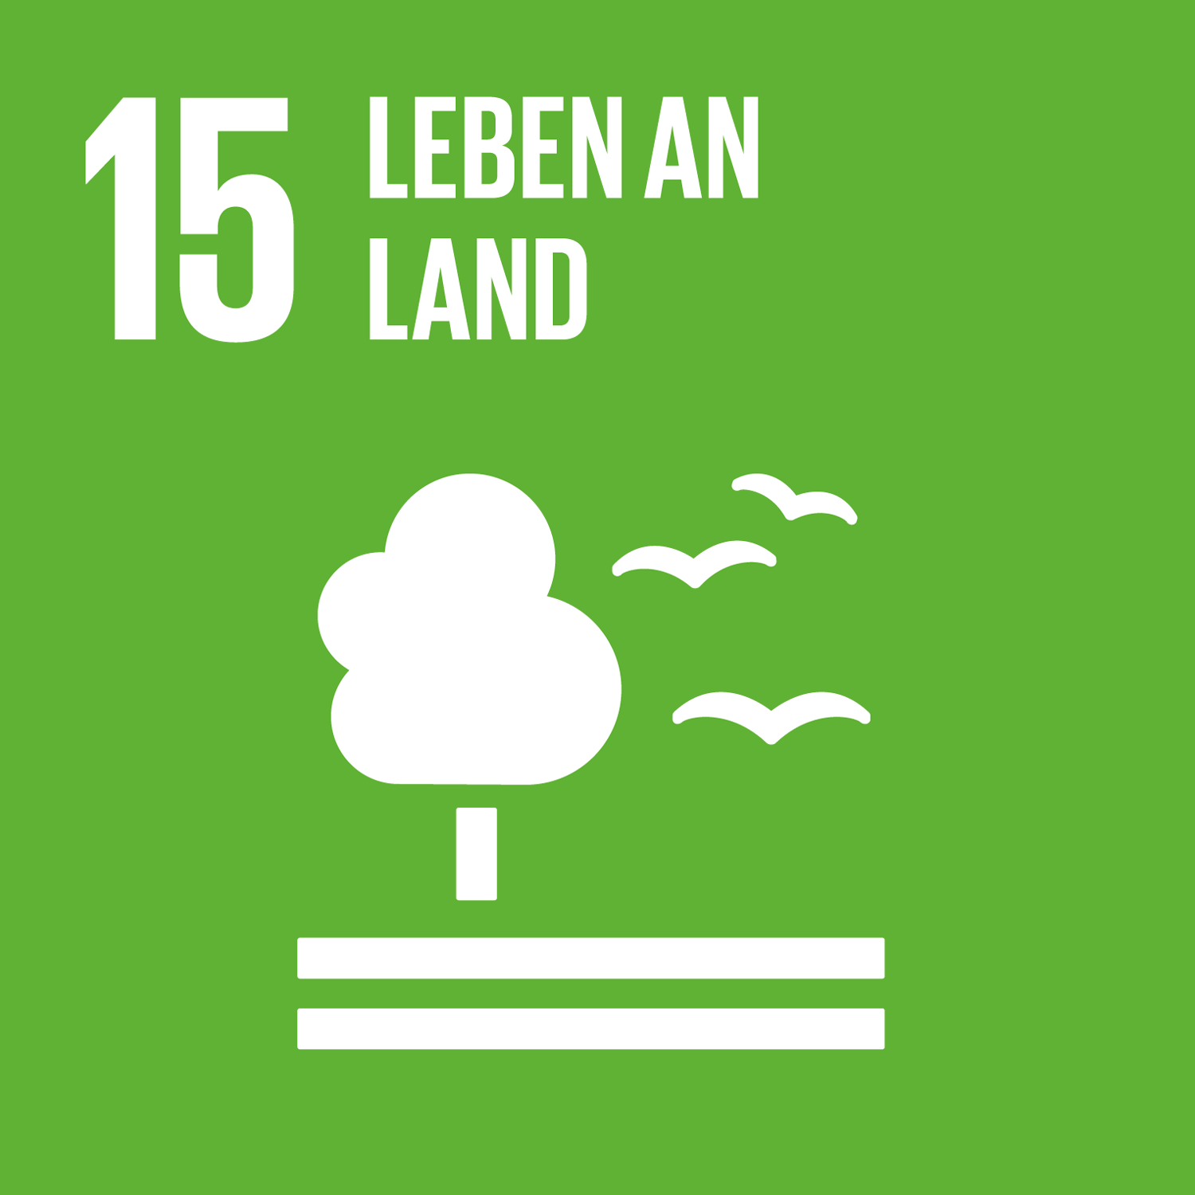
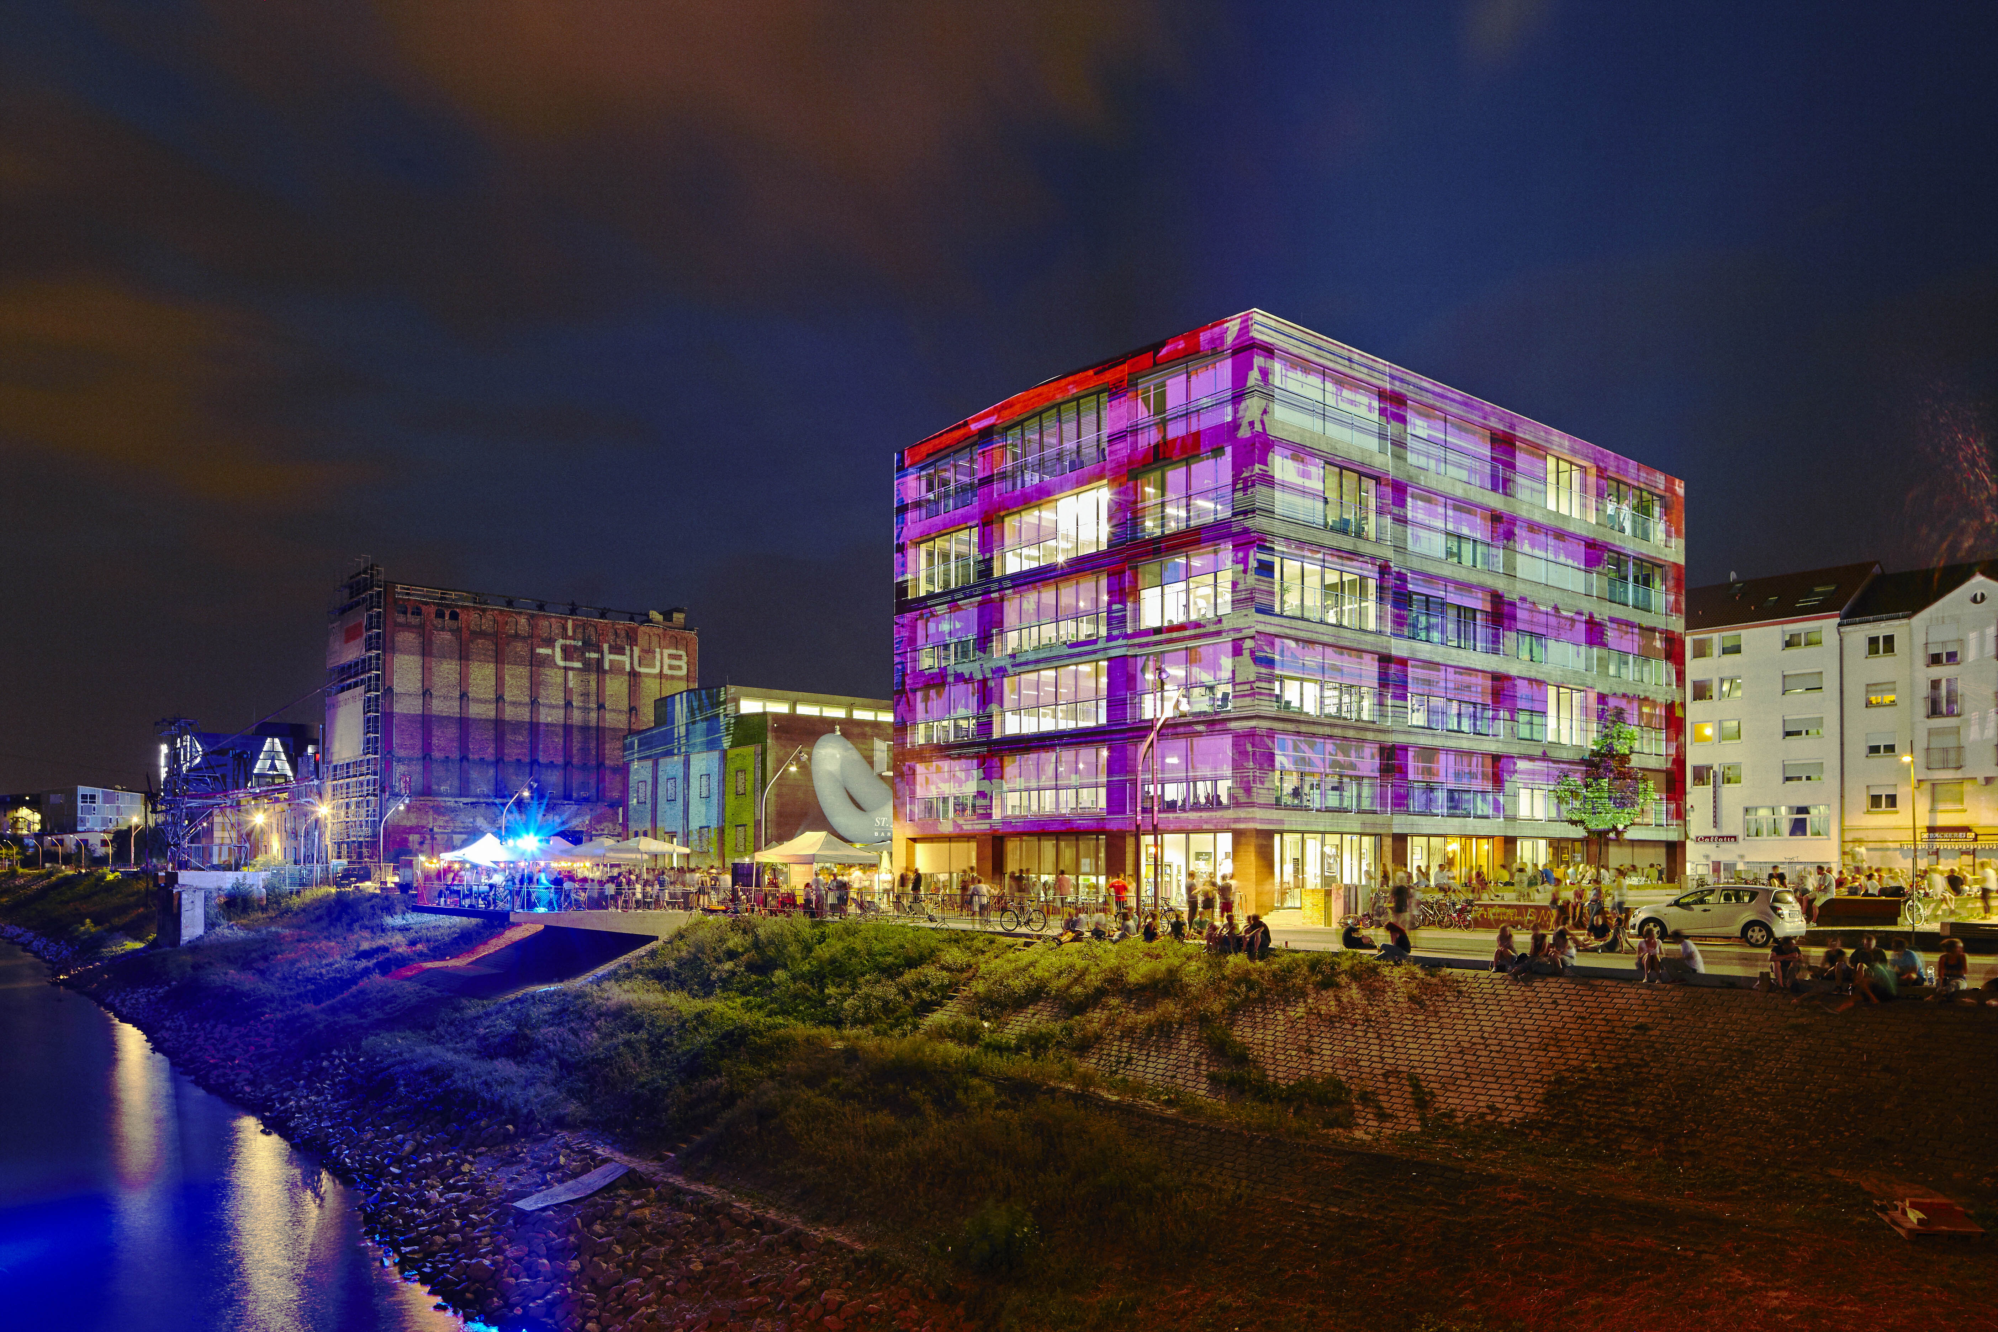
DIGITISATION, INNOVATION AND SUSTAINABLE VALUE CREATION
As a digital and innovative metropolis, Mannheim creates the conditions for companies of all sizes to realize diverse and sustainable value creation as well as to attract talent and skilled workers.
CLIMATE, ENVIRONMENT AND ALTERNATIVE MOBILITY
Digital Education for All Mannheimers Intelligent and Sustainable Mobility With E-Government Mannheim Exploits the Opportunities of Digitalization Smart Production and Creative Industries
Mannheim is a climate-friendly – climate-neutral – and resilient city that is a model for environmentally conscious living and acting.
Low-emission mobility Urban green ness increases quality of life, guarantees a good climate and biodiversity Life on the water Mannheim as a climate-friendly ecosystem Climate protection alliance of the economy Education for sustainable development
4

Slide 5
WHAT IS A VLR?
A report to the United Nations on the contribution of a municipality to achieving the UN's global sustainable development goals.
Report on the state of sustainability of a municipality.

Slide 6
BUILDING of the Mannheim VLRS
Introduction (SDGs, basics, etc.).
Presentation of Mannheim's strategic objectives and their relationship to the SDGs.
Projects to achieve goals.
Indicators.
Model resolution of the German City Association.
FAQ´s.

Slide 7
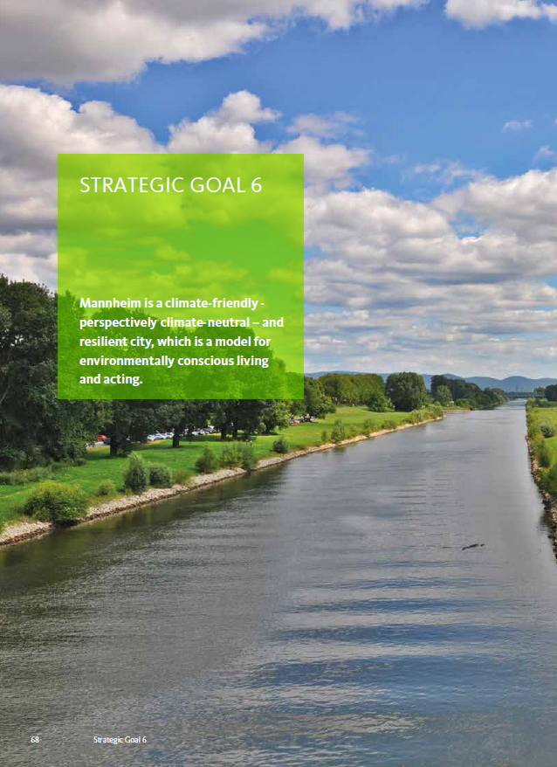
RELATED: EXAMPLE systematics at every STRATEGIC GOAL
Front page on the seven strategic objective.
"Mannheim is a climate-friendly – climate-neutral – and resilient city that is a model for environmentally conscious living and acting.“
7

Slide 8
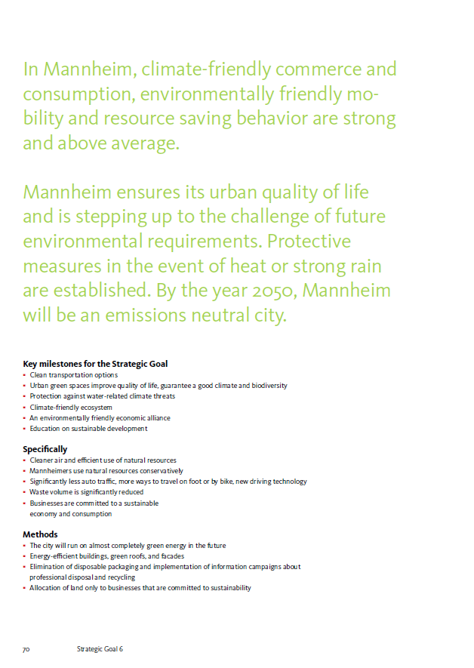
Excerpts from the VLR
Content on the seven strategic objective.
8

Slide 9
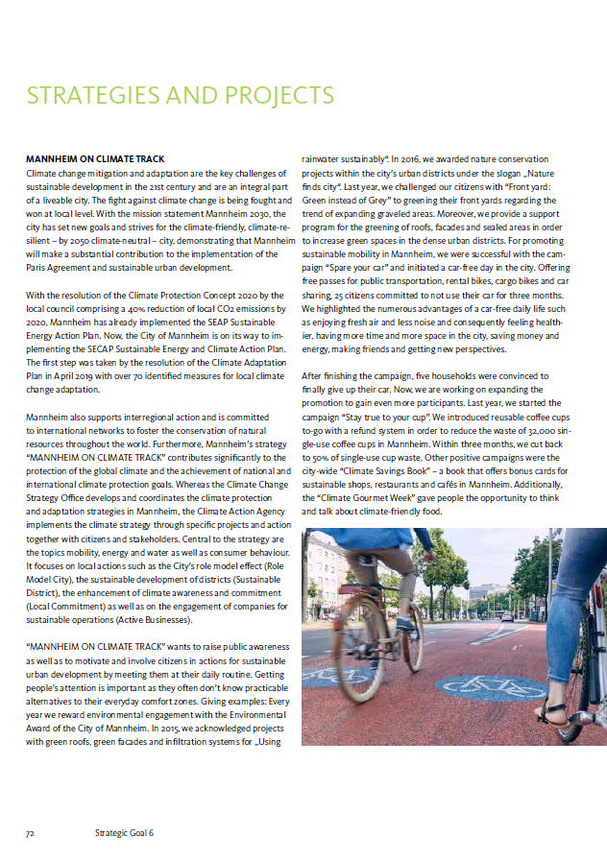
Excerpts from the VLR
Exemplary strategies and projects to achieve the sixth strategic goal.
Mannheim on course for climate protection.
9

Slide 10
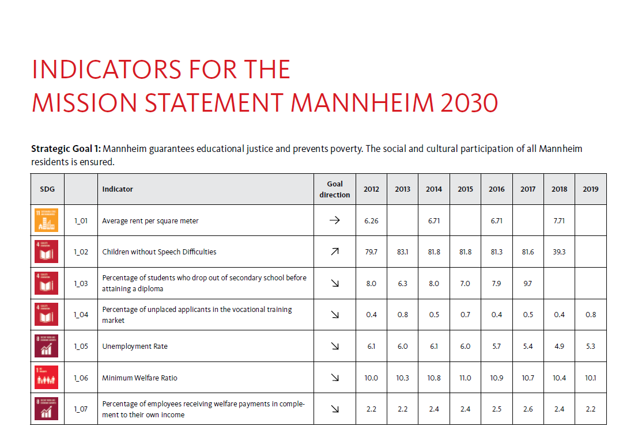
Excerpts from the VLR
10

Slide 11
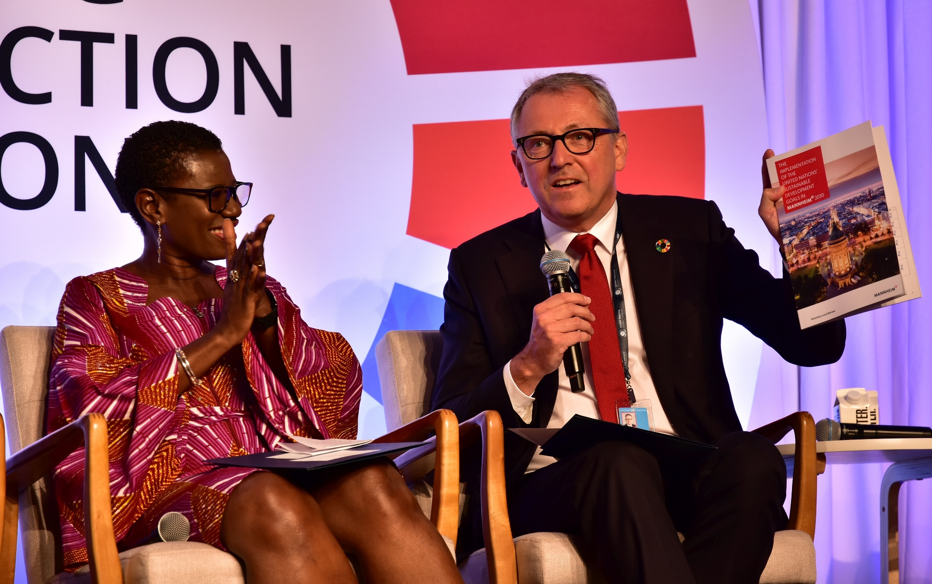
OB Dr. Peter kurz AT THE HLPF in New york
11

Slide 12

Advantages of a Voluntary local review, I
The development process of a VLR is just as important as the final product.
Mediation function of the VLR: SDGs are integrated into the day-to-day business of a city: The work on the SDGs is not an "annoying" or "moral" "add-on", but serves the development of the municipality itself.
Holistic view of urban development (social, educational, climate, economy, etc.).
Mosaic stone in the Collective Impact of all cities for the global achievement of SDG´S.
12

Slide 13
Advantages of a Voluntary local review, II
Raising awareness of urban decisions on SDG target levels 2 (How does our local action affect others in the world?)
Global benchlearning between cities is promoted.
The data collection process of a VLR promotes and forms the optimal basis for an evidence-based urban policy/discussion.
13

Slide 14
Thank you for your attention
CHRISTIAN W. HÜBEL
Fachbereich Demokratie&Strategie
RATHAUS E5 | 68159 MANNHEIM TEL.: +49 621 293 6660
MOBIL: +49 162 293 9009 CHRISTIAN.HUEBEL@MANNHEIM.DE
WWW. MANNHEIM.DE
https://www.local2030.org/vlrs
14

